Slide 1
The Community Health
Worker (CHW) and Suspected Adverse Drug Reaction (ADR) Reporting
Notes:
South Africa refers to Community Health Workers - CHW
Namibia refers to CHW and Health Extension Worker
Zimbabwe refers to Village Worker or Environmental Health Technician

Slide 2
Presenter(s): Date: Venue:
Place your organisation logo here
Notes:
The presenter(s) of the session must complete this slide with the relevant details that are applicable.
It is suggested that you do the following activities before you commence with the presentation:
1. Ice-Breaker: An example is provided, but you can replace it with your own ice-breaker.
2. Pre-presentation test: Allocate each attendee with a specific number – they must use this instead of their name on the pre- and post-test. This is to ensure that they are comfortable and that their responses in the test will remain anonymous. A copy of the pre–presentation test is provided. Print out adequate copies for your session.

Slide 3
Presentation Outline
Outcomes to achieve
Background & Terminology
Why is it important to report suspected ADRs?
Who are the stakeholders in ADR reporting?
Important role of CHWs in reporting suspected ADRs
How to recognize a suspected ADR?
ADR reporting process
Helpful tips to avoid ADRs
Helpful tips to avoid further harm / injury
Any questions?
ADR Reporting for CHWs

Slide 4
outcomes
to Achieve
ADR Reporting for CHWs
?
To know what is a suspected ADR
?
To create awareness around the importance of reporting suspected ADRs
To equip CHWs with knowledge and skills to recognise a suspected ADR
To provide pointers on how to identify/recognise/report a suspected ADR
To enable CHWs to refer patients with a suspected ADR

Slide 5
BACKGROUND & TERMINOLOGY
Medicines are crucial in fighting diseases (acute & chronic)
Medicines have the potential to cause harm, as well as unknown or unexpected side effects - sometimes referred to as an adverse event (AE) or adverse drug reaction (ADR)
This may occur: Within minutes / hours (e.g. breathing problems, rash, itchy skin, blisters) Few days (e.g. muscle pains & tiredness) Months / years (e.g. cancers or babies born with deformities)
When a medicine is causing side effects or symptoms, the patient should be encouraged to inform CHWs, nurses, doctors or pharmacists
ADR Reporting for CHWs

Slide 6
Side effect (SE)
Any unintended effect that occurs at normal dose, it is related to how this medicine works in the body and can be expected.
SE
Adverse drug reaction (ADR)
Harmful, unpleasant, and unintended responses to a medicine that occurred at normal dose when it was used to diagnose, prevent or treat a disease. Related to the medicine.
Adverse event (AE)
Any negative (unfavourable /unintended) occurrence after use of medicine. Often stated in context or circumstances prior to the occurrence. Not always related to the medicine !
AE
Adverse event following immunisation (AEFI)
Any negative occurrence experienced after immunisation (vaccination) took place.
AEFI
ADR Reporting for CHWs
Notes:
4 clicks to complete
As the presenter, you need to facilitate these definitions so that the CHW can understand what they mean. They may not have the experience, background and training to understand the difference in these three definitions. Sometimes these definitions / terminology are used interchangeably and it is academically not correct, as they are not the same.

Slide 7
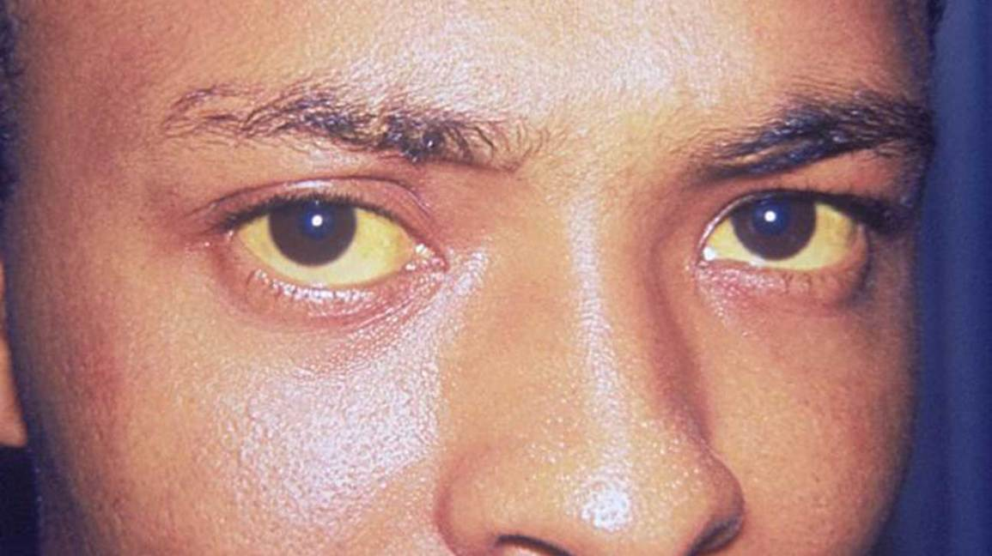
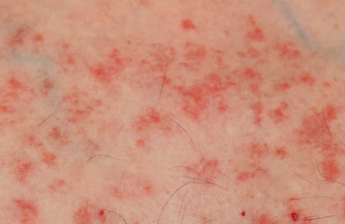
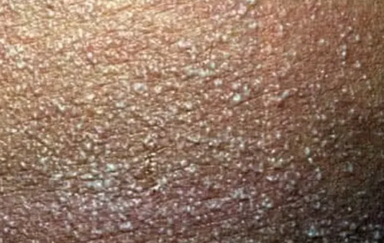
examples of some ADRs:
ADR Reporting for CHWs
Notes:
5 Clicks to complete.
Click to continue to indicate possible suspected ADRs examples associated with any medicine use.
Click 1 = Headache can be due to reduction in blood pressure, leading to dizziness.
Click 2 = Coughing can occur within a couple of days of use or after a long time since the initiation of certain medication. Coughing can disappear, but in some people it will not resolve and the treatment needs to be changed.
Click 3 = A serious ADR such as angioedema is the swelling of the lips, eyes and tongue. It can be dangerous when the throat is affected and swollen, as breathing can be impaired.
Click 4 = Examples of skin conditions.
Click 5 = Example of yellow eyes which can be a sign of jaundice.

Slide 8
Why is it important to report SUSPECTED Adverse Drug Reactions?
ALL medicines can potentially cause an ADR
Important to monitor the safety profile of medicines to prevent harm
The reporting of suspected ADRs is one such mechanism
ADR Reporting for CHWs

Slide 9
Why is it important to report SUSPECTED Adverse Drug Reactions?
ADRs can affect a client’s quality of life and should be prevented
ADRs can impact negatively on disease states and can cause death
ADRs can cause poor medication adherence
ADRs can cause unplanned / prolonged hospitalisation - increased burden / costs to health care system
ADR reporting can help to ensure public health safety - promote rational and safe use of medicines
ADR Reporting for CHWs

Slide 10
WHO ARE THE KEY STAKEHOLDERS IN adverse drug reporting?
Clients – General public
Health care professionals (doctors, nurses, pharmacists etc) Community Health Workers (CHWs)
Pharmaceutical Companies
Regulatory Authority, Ministry of Health together with public health programmes (TB; HIV & Immunisation)
ADR Reporting for CHWs
Notes:
2 Cliks

Slide 11
important role of CHWs IN REPORTING suspected ADRs
CHWs can create awareness in the community of suspected adverse drug reporting and how it should be done
CHWs are integrated in communities, work directly with clients and are ideal to interact with clients
CHWs have the trust of the community * In the community * From the community * For the community
CHWs are in close contact with clients to communicate medicine use
CHWs can: * help to identify suspected ADRs * report suspected ADRs * help to make timely referrals
Patients feel comfortable to discuss their medicines with CHWs
ADR Reporting for CHWs
Notes:
6 Clicks

Slide 12
HOW TO RECOGNISE A SUSPECTED ADR?
1. CLIENT
2. MEDICINE
Ask about specific signs, symptoms and severity
Ask about the client’s history of previous ADRs / allergies
Ask about medical history other illnesses (deterioration/worsening)
Review current / recent medication (over the counter & traditional medicine, drug use)
Ask when suspected reaction first appeared (date?)
Which medicines were started and when (date/timeline)?
If suspected medicine was stopped, did it result in improvement of the suspected ADR?
ADR Reporting for CHWs
Notes:
2 Clicks
Role Play (see Appendix IV) & Take a break
For the role play it is suggested that the trainee attendees work in pairs. First they need to study this slide. They must decide who will be the patient and who will be the CHW. The patient must present with some kind of suspected ADR. The CHW must engage with the patient and use the information on the slide to obtain relevant information from the patient to decide if there is a possible suspected ADR that needs to be referred / reported.

Slide 13
?
ADR reporting PROCESS?
WHAT
HOW
WHO
WHEN
WHY
WHERE

Slide 14
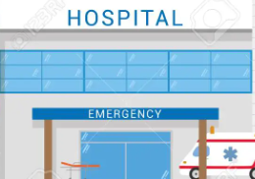
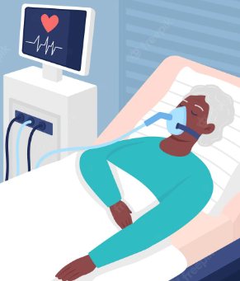
The WHO defined these as serious events:
What
is a serious event ?
ADR Reporting for CHWs
Death
Hospitalisation or prolonged hospitalisation
Birth defects
Any life-threatening event
Disability or incapacitation

Slide 15
DECISION-MAKING PROCESS TO REPORT OR NOT
Do you suspect a possible ADR?
Yes
Yes
Is it a serious effect, sign
or symptom(s)?
REFER to OTL / REPORT to facility nurse
No
Is it a child, pregnant woman
or elderly person?
Yes
REFER to OTL / REPORT to facility nurse
REFER or REPORT even if you are unsure about the incident
ADR Reporting for CHWs
Notes:
6 Clicks
Clarifications of terms that may be used interchangeably in different countries.
OTL – Outreach Team leader in South Africa is a supervisor of the respective CHW.
In Namibia & Eswatini it is possible for CHWs to report ADRs directly which is not the preferred route in South Africa
General ADR reporting options in South Africa : Other countries can change this to align with their country specific processes
Report it to a healthcare practitioner / clinic / hospital.
The ADR reports must be sent to:
NDoH Pharmacovigilance Centre for Public Health Programmes, Private Bag X828, Pretoria, 0001. Tel: 012 395 8176/8 or email NPC@health.gov.za, or on an Adverse Drug Reactions reporting form (available from NPC@health.gov.za)
and/or
South African Health Products Regulatory Authority (SAHPRA) by email: adr@sahpra.or.za www.sahpra.co.za Adverse Drug Reactions & Quality problem reporting form (available on SAHPRA website) Adverse Event Following Immunisation (AEFI) / Adverse Events of Special Interest (AESI) reporting forms (available on SAHPRA website) Electronic reporting
Med Safety App
and/or Electronic reporting on the following apps: TB Clinical Guide, HIV Clinical Guide and SA Clinical Guidelines and EML. Search for ‘Reporting ADRs' under ‘Tools’.
3. Follow provincial reporting procedures: each province has its own.
4. Direct reporting to the Pharmaceutical applicant (contact details on the Package Information Sheet or PIL).

Slide 16
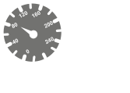
REPORTING BY CHWs
Report suspected serious reactions to: OTL, facility nurse, primary health care clinic, hospital
All suspicious reactions to be reported – even if you are unsure
You don’t have to be certain in order to report it
PLEASE REPORT ALL SERIOUS SUSPECTED ADRs
ADR Reporting for CHWs
Notes:
OTL (Outreach Team leader), Facility nurse – terms used in South Africa

Slide 17
ADR Reporting for CHWs
Helpful tips to avoid adverse drug reactions
BEFORE taking medication
The client must KNOW their medicines well.
Client to INFORM the CHW, doctor, nurse, pharmacist which medicine they are taking.
Client to INFORM the CHW of any previous reactions or allergies to medicines.
Client not to borrow / share medicines.

Slide 18
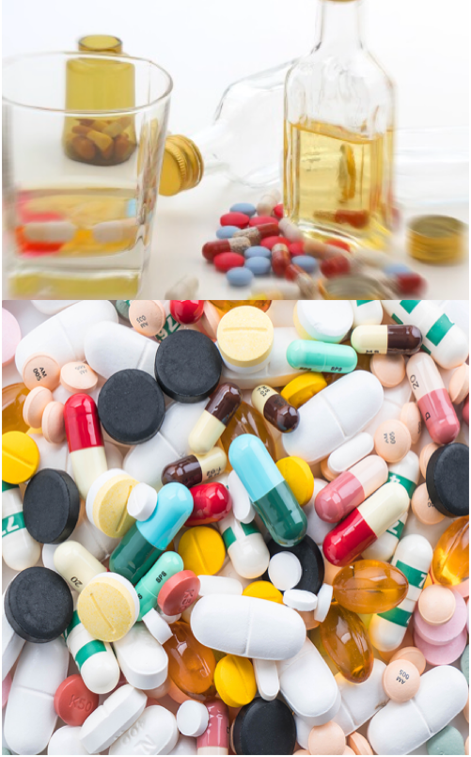
ADR Reporting for CHWs
Helpful tips to avoid adverse drug reactions
WHEN taking medication
Don’t mix medicine with alcohol.
Don’t mix medicine into hot water unless instructed to do so.
Don’t take vitamins simultaneously with other medicine.
Follow the instructions on the medicine label carefully.
Take medicine at same time of the day. Keep a diary of when medicine was taken.
Don’t suddenly stop taking chronic medication.
Remember to collect monthly repeat medication on time.
Notes:
.

Slide 19
ADR Reporting for CHWs
Helpful tips to correctly store ALL medicines
STORAGE of medication
Read the storage instructions on all package information first.
Don’t mix medicine into hot water unless instructed to do so.
Don’t store any medicine in the sun or where it can get wet (bathroom).
Medicines are best stored in original container.
Thermo labile: Vaccines, injections, insulin – Read the special storage instructions carefully as many of them need to be stored < 8ºC.
Medicines not stored properly can result in suspected ADR or lack of efficacy

Slide 20
ADR Reporting for CHWs
Helpful tips to avoid further harm / injury
AFTER taking medication
GET IMMEDIATE HELP IF:
Breathing problems
Difficult swallowing, swollen lips, face, body
Extreme muscle pain, urine discolouration
Rash, blisters or sores appear
Increase in heart rate
Yellowing of eyes (Jaundice)
Change in vision or hearing
Pins and needle sensation in hands & feet (tingling / numbness)
Vomiting, stomach pains
Notes:
Click to get the corresponding images to come up as you mention the symptom / sign.

Slide 21
Detect & report safety problems related to medication from single client
Promote rational, safe, cost-effective use of medication
CHWs can: ⬆ Client / public health & safety with just ONE report
Various reports combined to enhance early detection of safety issues
Promote understanding, education & awareness to the public
Contribute to assessment of ( benefit  harm) Changes in treatment guidelines
Communicate safety findings (e.g COVID-19 and vaccines)
Notes:
6 Clicks
This is just to highlight (reinforce) to the CHW how important suspected ADR reporting is. It depicts how the reporting of ONE suspected ADR can contribute to the entire system of medicine safety and what influence (impact) it can have in the bigger overall picture of medicine safety.

Slide 22
Any questions?
Notes:
Tips:
Provide time for the trainee attendees to ask questions about the presentation or other ADR related questions they may have.
Post-presentation test (Appendix III) to be completed. (This is the same test as the pre-presentation.) Attendees must indicate their same allocated number on the post-presentation test.
The attendees must each complete the Evaluation and Feedback form (Appendix V)

Slide 23
Siyabonga
Enkosi
Thank you
Dankie
Eswatini
Namibia
South Africa
Zimbabwe
Notes:
“Thank you” in the other most commonly spoken languages can be included here for Namibia; Eswatini and Zimbabwe.

Slide 24
ACKNOWLEDGEMENTS
This material was developed as a collaborative effort between the SPaRCS members (Prof Michelle Viljoen; Dr Mukesh Dheda and Dr Hazel Bradley) and TB HIV Care.
This material was produced by SPaRCS which is part of the EDCTP2 programme supported by the European Union (grant number CSA2018ERC-2332 SPaRCS). The views and opinions of authors expressed herein do not necessarily state or reflect those of EDCTP.

